Slide 1
Training Linear Regression
Ch 2.4
Train the Model with Gradient Descent Algorithm

Slide 2
Content
Gradient Descent
Implementing Gradient Descent
Gradient Descent Intuition
Learning Rate
Gradient Descent for Linear Regression
Running Gradient Descent
Optional Lab: Gradient Descent

Slide 3
Gradient Descent Algorithm
Gradient descent is an iterative optimization algorithm commonly used in machine learning to minimize the cost (loss) function J(w, b) by adjusting model parameters in the direction of the steepest descent of the cost surface.
Learning how Gradient Descent works is one of the main building block s of how machine learning works

Slide 4
Where do we use it
Linear Regression: Gradient descent is used to optimize the weights of a linear regression model to minimize the mean squared error (MSE) between predicted and actual values.
Logistic Regression: Gradient descent is used to optimize the weights of a logistic regression model to minimize the loss and improve its ability to classify data points.
Neural Networks: Gradient descent is the primary algorithm for training neural networks. It is used to adjust the weights and biases of the network's connections to minimize the loss function and improve its performance on a given task.
Support Vector Machines (SVMs): Gradient descent is used to optimize the hyperparameters of SVMs to find the optimal decision boundary that maximizes the margin between the two classes.
Regularization Techniques: Gradient descent is often used in conjunction with regularization techniques, such as L1 and L2 regularization, to prevent overfitting and improve the generalization ability of machine learning models.

Slide 5
Review of linear regression
What can we do with Gradient Descent
Have some function J(w,b), cost function,
Want to minimize J(w,b) with respect to w and b:
Can be use for J(w,b), or any other function, even with large number of parameters:
min J(w,b)
w,b
min
w₁, …,w_{𝑛},𝑏
𝐽 (𝑤₁, 𝑤₂, … , 𝑤_{𝑛}, 𝑏)
How is that implemented:
Start with some initial values for w, b, for example: w= 0, b=0
Keep changing w, b to reduce J(w,b)
Keep changing until it settle at or near a minimum value.
There is a possibilty of having more than 1 local minimum
Gradient Descent can help us
find the values of w_{n} and b
that give the minimum value
for J(w₁, w₂, w₃, ... w_{n}, b)

Slide 6
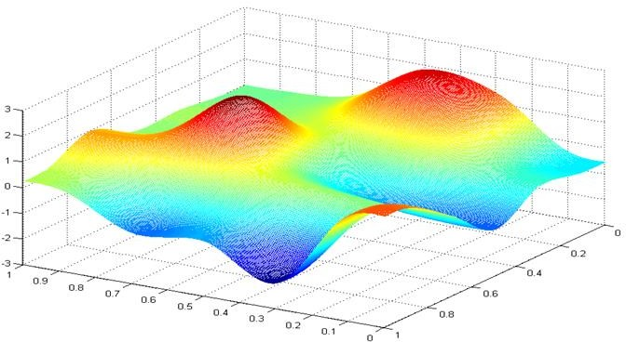
𝐽 𝑤, 𝑏
Graphical Representation of Gradient Descent
𝑤
𝑏
you are standing here
and you want to reach the
minimum point(s)

Slide 7

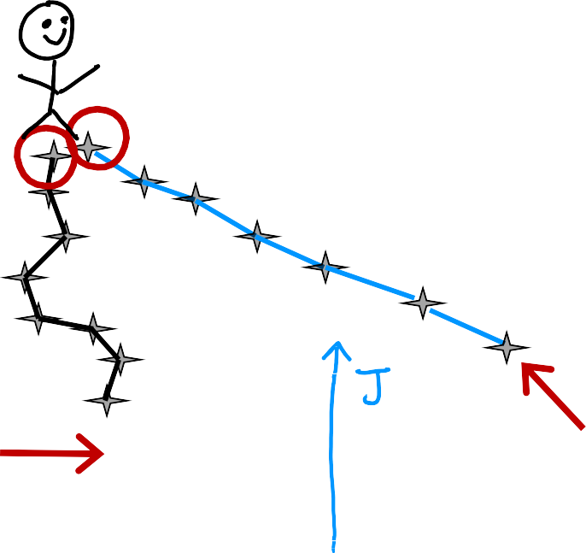
𝐽 𝑤, 𝑏
Graphical Representation of
Gradient Descent
you are standing here
and you want to reach the
minimum point(s)
𝑏
𝑤
Local minima
Starting at different points migh lead to different minima which means different values for w, b

Slide 8
What do we conclude
To find the regression model, we need to find the values of w and b, such that y(x) = wx + b
To find the w, and b, we use the cost function J(w,b), which calculates the difference between True values and Predicted values
To find the values of w and b, we minimize J(w,b) by changing the values of w and b, so we search for w, b that make the cost function J(w,b) minimum.
One of the best way to find w and b is to use the Gradient Descent algorithm, that was graphical described in this part
In the upcoming section we look at the mathematical expressions
of Gradient Descent

Slide 9
Implementing Gradient Descent
in Mathematical Expressions

Slide 10

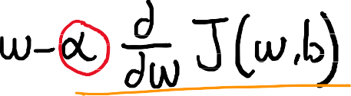
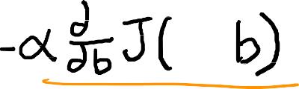



Gradient descent algorithm: the expression
old value
of w
The equal sign (=) in the expression
is the assignment operator, which
assign the right value to the left
variable.
e.g. a = a + 1
means take the old value of a and
add 1 to it and assign the value
to the new a.
Partial Derivative
new values
of w
Learning Rate
Simultaneously update w and b
Andrew Ng

Slide 11
Gradient descent algorithm: the expression
old value
of w
The learning rate α (alpha)
in gradient descent is a crucial hyperparameter that controls the step size at each iteration. A higher learning rate leads to larger updates, while a lower learning rate leads to smaller updates.
Partial Derivative
new values
of w
Learning Rate
Simultaneously update w and b
Andrew Ng

Slide 12
Gradient descent algorithm: the expression
old value
of w
The Partial Derivative:
The partial derivative term indicates the direction and magnitude of the steepest descent of the cost function,
(i.e. the slope), guiding the algorithm's step towards minimizing the cost function J(w,b).
Partial Derivative
new values
of w
Learning Rate
Simultaneously update w and b
Andrew Ng

Slide 13


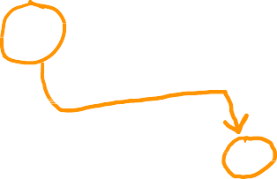
Gradient descent algorithm
Simultaneously update w and b
When updating w and b simultaneously, the algorithm considers the combined effect of both parameters on the error.
This ensures that the updates are coordinated and lead to an overall improvement in the model's fit.
These update rules are applied simultaneously, meaning that both w and b are adjusted in the same iteration.
Repeat until convergence
∂
𝑡𝑚𝑝_𝑤 = 𝑤 − 𝛼 _{∂𝑤} 𝐽 𝑤, 𝑏
___
∂
𝑡𝑚𝑝_b = 𝑏 − 𝛼 𝐽 𝑤, 𝑏
∂𝑏
𝑤 = 𝑡𝑚𝑝_𝑤
𝑏 = 𝑡𝑚𝑝_𝑏
(w, b) = (w - α * ∂J/∂w, b - α * ∂J/∂b)
Andrew Ng

Slide 14
What do we conclude ...
What are w and b?
w (weight): Represents the slope of the line in linear regression. It indicates how much the predicted value changes as the input value changes.
b (bias): Represents the intercept of the line in linear regression. It indicates the predicted value when the input value is zero.
What are the update equations?
w = w - α * ∂E/∂w: This equation updates the weight (w) based on the partial derivative of the loss function (∂E/∂w) and the learning rate (α).
b = b - α * ∂E/∂b: This equation updates the bias (b) based on the partial derivative of the loss function (∂E/∂b) and the learning rate (α).

Slide 15
What do we conclude
What do the partial derivatives mean?
The partial derivatives (∂E/∂w and ∂E/∂b) indicate the direction and magnitude of the steepest descent of the loss function.
In simpler terms, they tell us which way to adjust the parameters (w and b) to reduce the error more effectively.
What does the learning rate (α) do?
The learning rate (α) controls the step size of the updates.
A larger learning rate leads to faster convergence but may cause overshooting the minimum.
A smaller learning rate leads to slower convergence but is less likely to overshoot the minimum.

Slide 16
What is the overall goal?
The goal of these equations is to iteratively adjust the parameters (w and b) to minimize the loss function, which ultimately improves the model's fit to the data.
In essence, these equations are the core of the gradient descent algorithm, enabling it to optimize the parameters of a model and achieve better predictions.
To understand how updates get occured, we need to review
the partial derivative

Slide 17
Gradient Descent Intuition
This section explain the role of the learning rate and the derivative
terms in deciding the updates of w and b

Slide 18
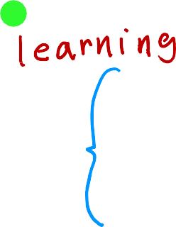
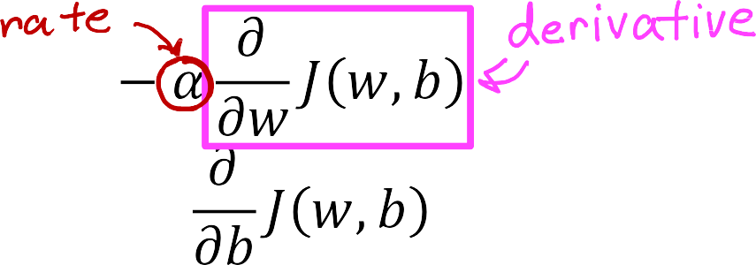
Gradient descent algorithm
Just to make the calculation
simple we will use one
parameter only (w)
repeat until convergence {
𝐽 𝑤
min 𝐽 𝑤
w
The learning rate determines how big is the step we take when we update w and b

Slide 19
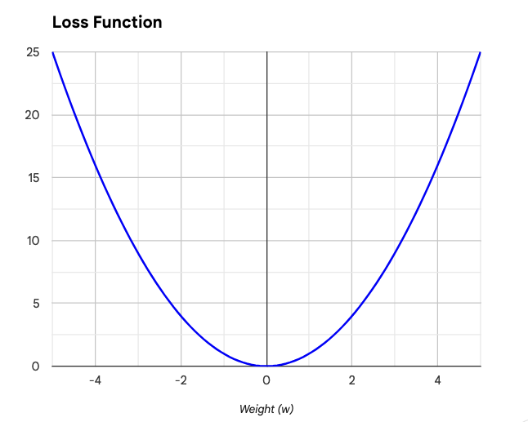
The impact of the derivative on the parameters updates
Derivative = slope of J(w) = C/A = +
J(w)
w = w - α. Derivative(positive number)
α: is always positive number
w(new) = w(old) – positive value
w will move to the left, in the direction of the minimum
C
A
w is decreasing towards the min
initialize w at this point

Slide 20
The impact of the derivative on the parameters updates
Derivative = slope of J(w) = - (negative)
J(w)
w = w - a. (negative number)
a: is always positive number
w(new) = w(old) + positive value
w will move to the right, in the direction of the minimum
w is increasing towards the min
This means that the gradient descent is doing
something resonable, i.e. moving with J(w)
towards the min.
initialize w at this point

Slide 21
To conclude ...
This derivative indicates the sensitivity of the loss function to changes in w. A positive derivative implies that increasing w will reduce the loss, while a negative derivative suggests that decreasing w will reduce the loss.
The weight update rule, also known as the gradient descent algorithm, utilizes the derivative to adjust w in the direction that minimizes the loss.
In summary, the derivative of the loss function serves as a guiding signal for updating the weight parameter, ensuring that the weight moves towards the value that minimizes the overall loss.
But what is the role of the learning rate a ?

Slide 22
Learning Rate
w = w – α * dJ/dw
where: α is the learning rate, which controls the step size of the update
The main question becomes, how fast we shall be moving towards the minimum,
or what determines the speed of change towards the min.

Slide 23
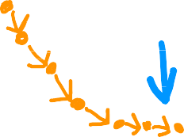
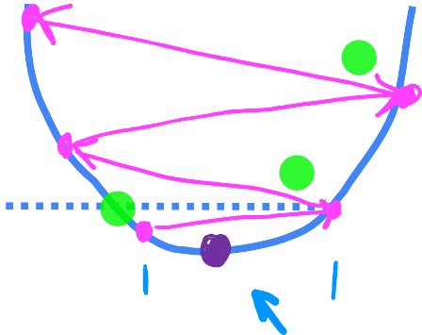
𝑤 = 𝑤 − 𝛼
𝑑
small steps
𝐽 𝑤
𝑑𝑤
𝐽(𝑤)
minimum
If 𝛼 is too small…
Gradient descent may be slow, and it might take long time to converge
𝑤
large steps
If 𝛼 is too large…
Gradient descent may:
Overshoot, never reach minimum
Fail to converge, which means diverge
𝐽(𝑤)
𝑤
minimum
the algorithm skips the minimum

Slide 24
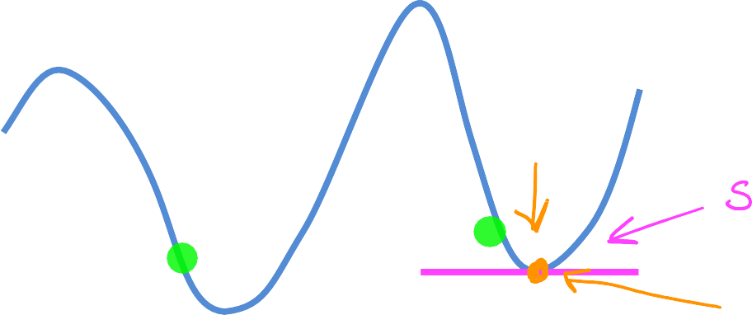






What if the value of w is at the minimum ??
𝐽(𝑤)
local minimum
𝑤
current value of 𝑤
At the minimum point the slope = 0
w = w – a (derivative)
w = w – a (0)
w = w
If the algorithm reaches the minimum, then further steps will do nothing

Slide 25



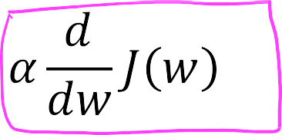

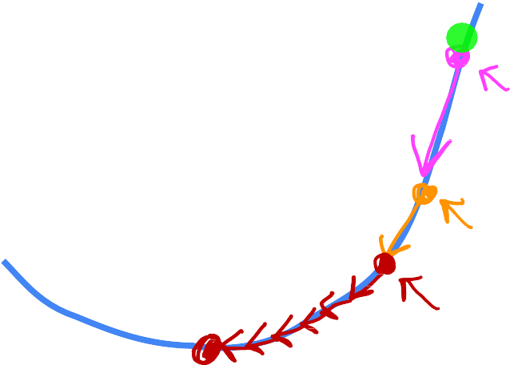

Can reach local minimum with fixed learning rate
not as large
large
𝐽 𝑤
large slope
Near a local minimum,
Derivative becomes smaller
Update steps become smaller
Can reach minimum without decreasing learning rate
smaller
even smaller
𝑤
minimum

Slide 26
To conclude ...
The learning rate α plays a crucial role in the convergence process of model parameters, influencing the speed and stability of the optimization algorithm. It determines the step size of the adjustments made to the model parameters during each iteration of the training process.
Optimal learning rate: The optimal learning rate strikes a balance between speed and stability, guiding the algorithm towards the desired minimum while avoiding oscillations or getting stuck. Finding the optimal learning rate requires careful experimentation and hyperparameter tuning.
So far we applied the gradient descent in general. So lets see how it can be applied to linear regression

Slide 27
Gradient Descent for Linear Regression
We have discussed the linear regression model,
and then developed the concept of the cost function,
and then develop the gradient descent to find the minimum,
now we will bring all these together

Slide 28



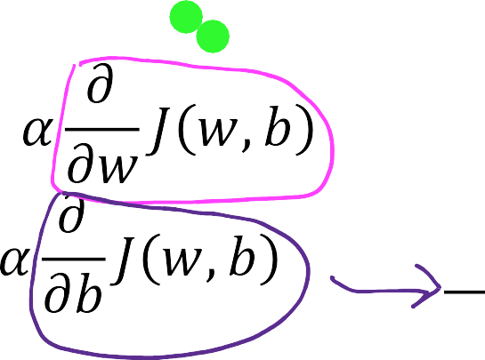






Cost function
Linear regression model
ƒ_{w,𝑏}(𝑥) = 𝑤𝑥 + 𝑏
Gradient descent algorithm
repeat until convergence
{
}
how do we get these formulas ... Calculus

Slide 29
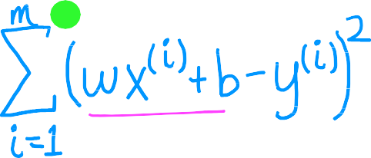


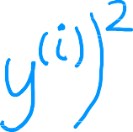



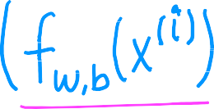

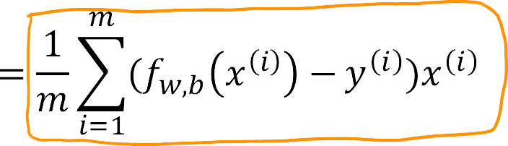
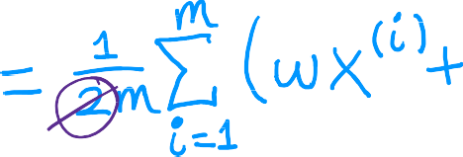
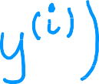
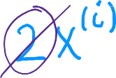

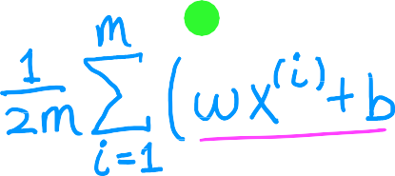
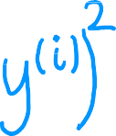

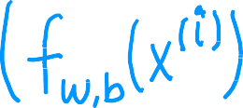

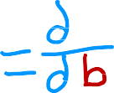



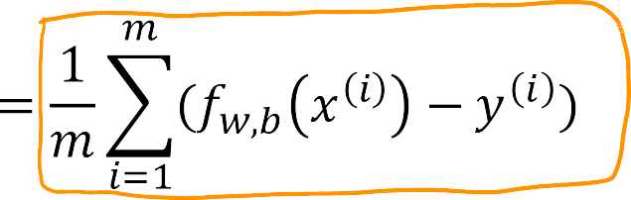
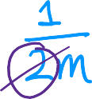
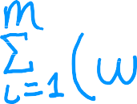

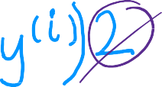



∂
_{∂𝑤} 𝐽 𝑤, 𝑏 =
__
∂
_{∂𝑏} 𝐽 𝑤, 𝑏 =

Slide 30





The linear Model
The cost function
the cost function as a function of x^{(i)}
the derivative of the cost function with
respect to w
the derivative of the cost function with
respect to b

Slide 31



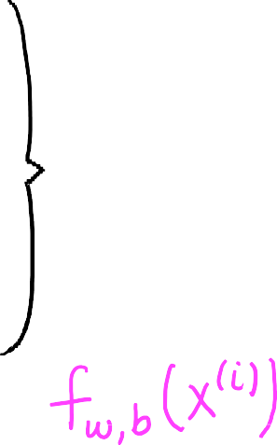









Gradient descent algorithm
repeat until convergence {
Update
𝑤 and 𝑏
simultaneously
}

Slide 32




More than one local minimum
When we have more than one local minimum, then the minimum that the algorithm converges to depends on the value that we started at
𝐽 𝑤, 𝑏
𝑏
𝑤

Slide 33



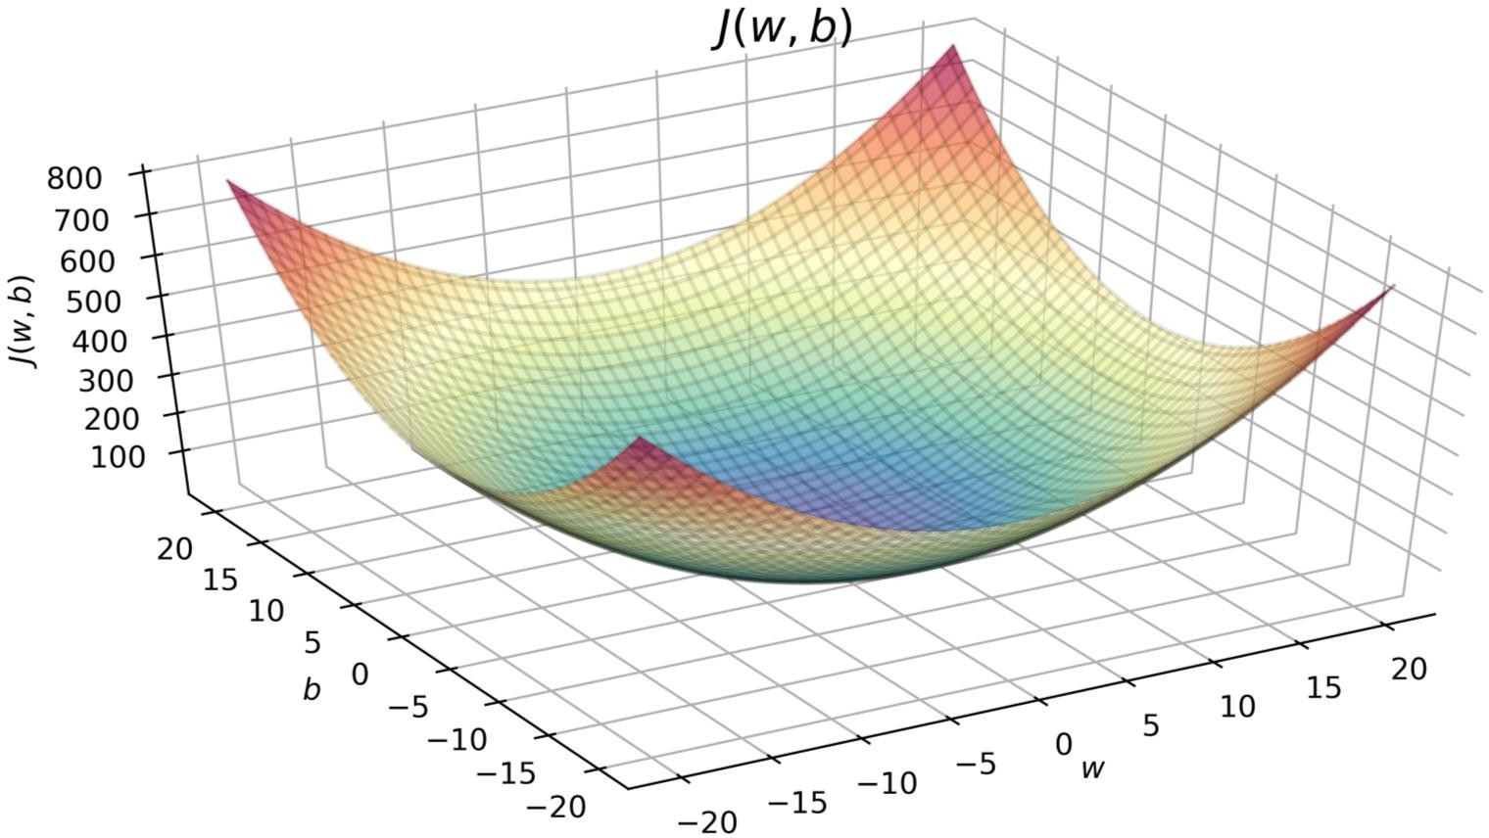
Squared Error Cost Function
convex function
global minimum
𝑤
𝑏
There is only one minimum for the squared error cost function since it is a convex function

Slide 34
Running Gradient Descent

Slide 35
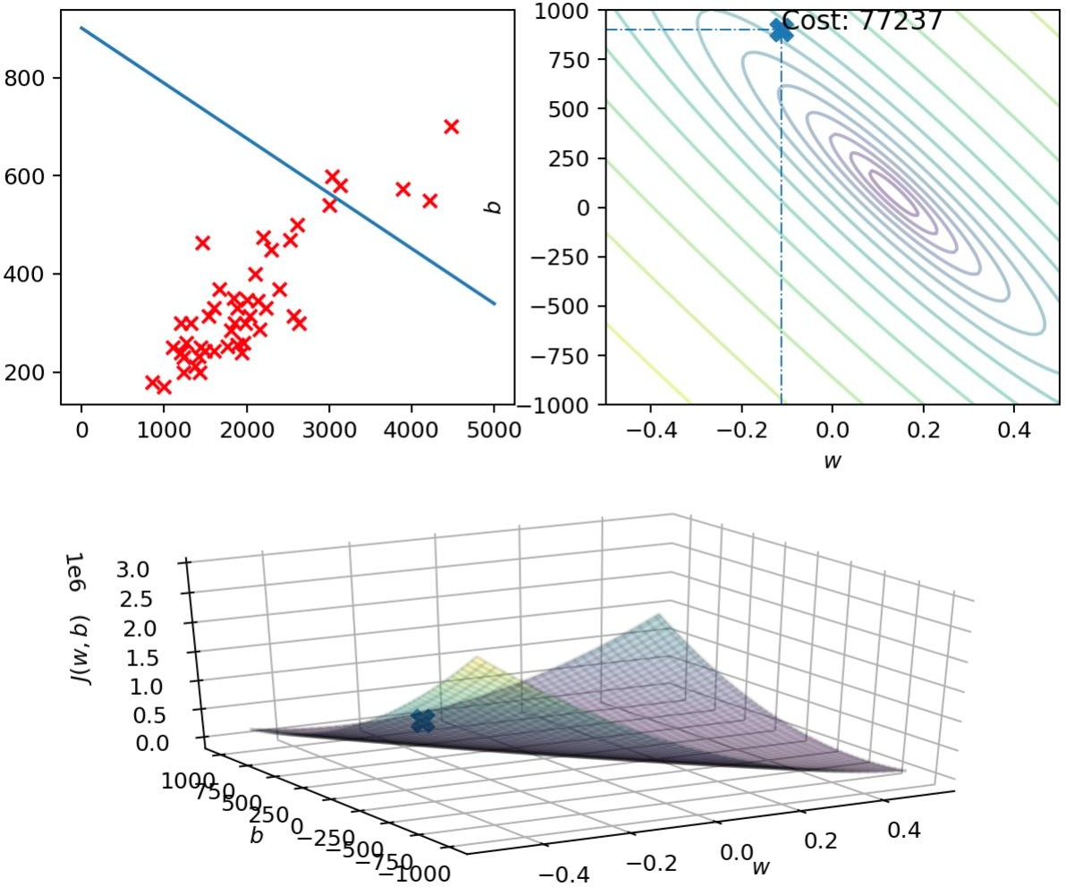







ƒ_{w,𝑏} 𝑠i𝑧𝑒
𝐽 𝑤, 𝑏
pric e in
$1000's
size in feet²
𝐽 𝑤, 𝑏

Slide 36
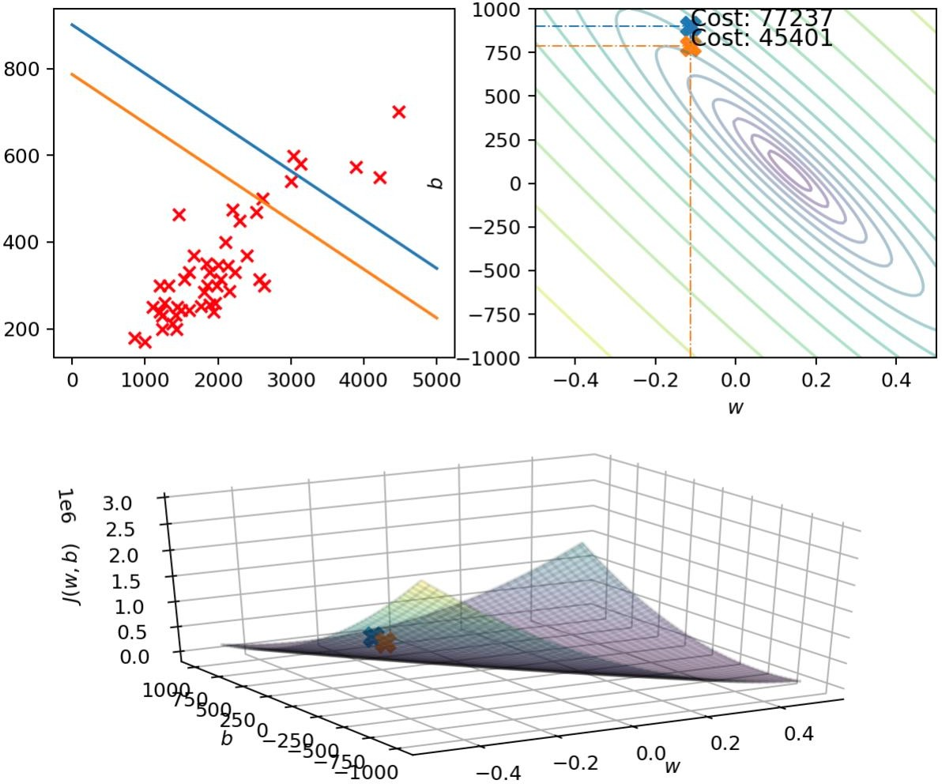
ƒ_{w,𝑏} 𝑠i𝑧𝑒
_{𝐽} 𝐽 , 𝑤, 𝑏
𝑤 𝑏
ƒ_{w,𝑏} 𝑠i𝑧𝑒
𝐽 𝑤, 𝑏
pric e in
$1000's
size in feet²
𝐽 𝑤, 𝑏
size in feet²
𝐽 𝑤, 𝑏

Slide 37
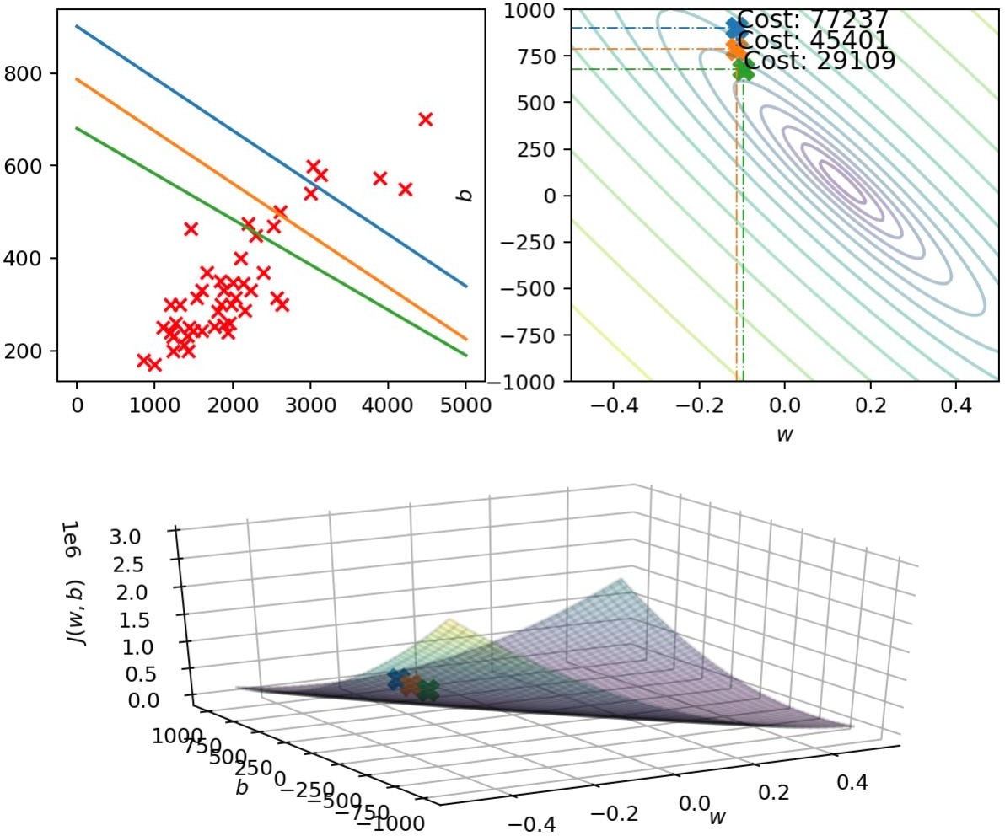
ƒ_{w,𝑏} 𝑠i𝑧𝑒
𝐽 𝑤, 𝑏
𝐽 𝑤, 𝑏

Slide 38
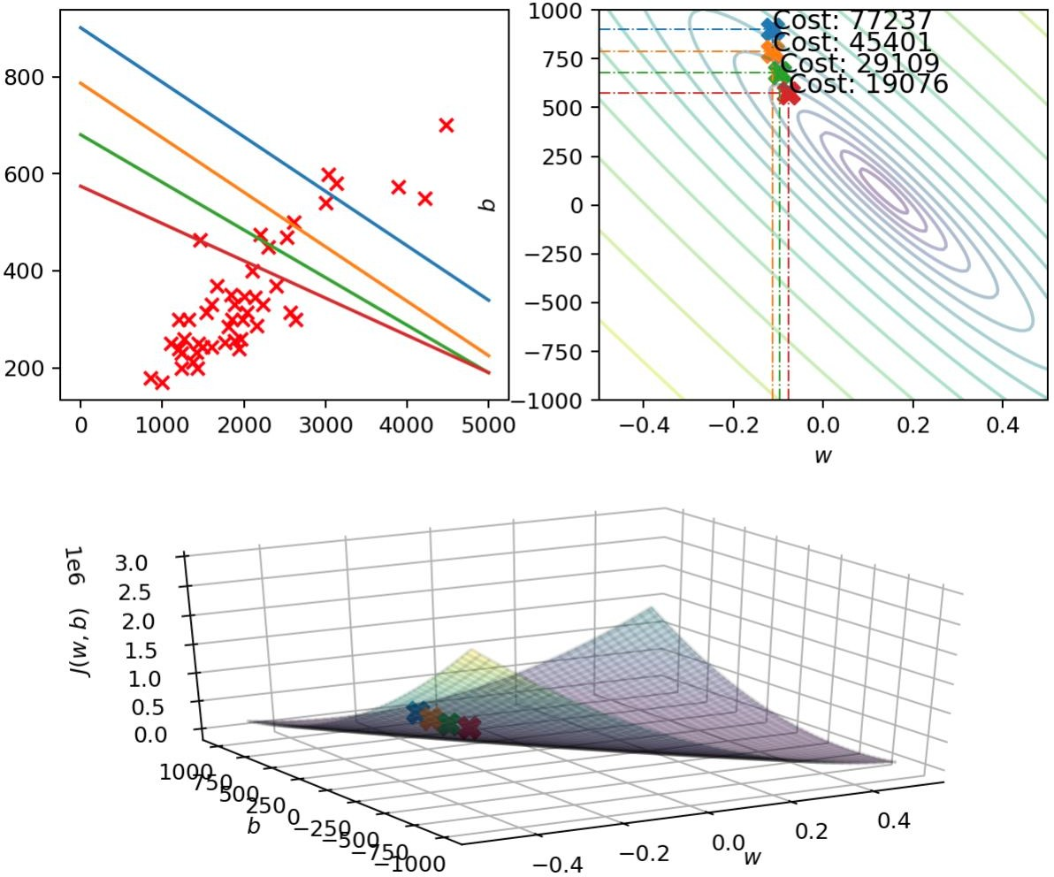
ƒ_{w,𝑏} 𝑠i𝑧𝑒
𝐽 𝑤, 𝑏
ƒ_{w,𝑏} 𝑠i𝑧𝑒
𝐽 𝑤, 𝑏
pric e in
$1000's
size in feet²
𝐽 𝑤, 𝑏
𝐽 𝑤, 𝑏

Slide 39

ƒ_{w,𝑏} 𝑠i𝑧𝑒
𝐽 𝑤, 𝑏
pric e in
$1000's
size in feet²
𝐽 𝑤, 𝑏

Slide 40
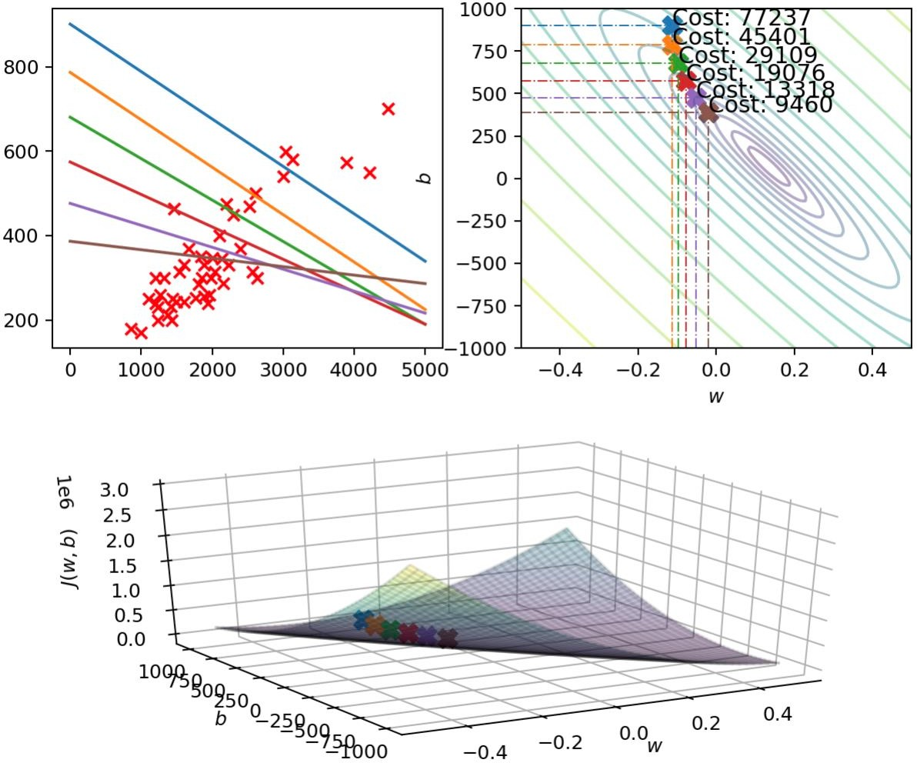
ƒ_{w,𝑏} 𝑠i𝑧𝑒
𝐽 𝑤, 𝑏
ƒ_{w,𝑏} 𝑠i𝑧𝑒
𝐽 𝑤, 𝑏
pric e in
$1000's
size in feet²
𝐽 𝑤, 𝑏
𝐽 𝑤, 𝑏

Slide 41
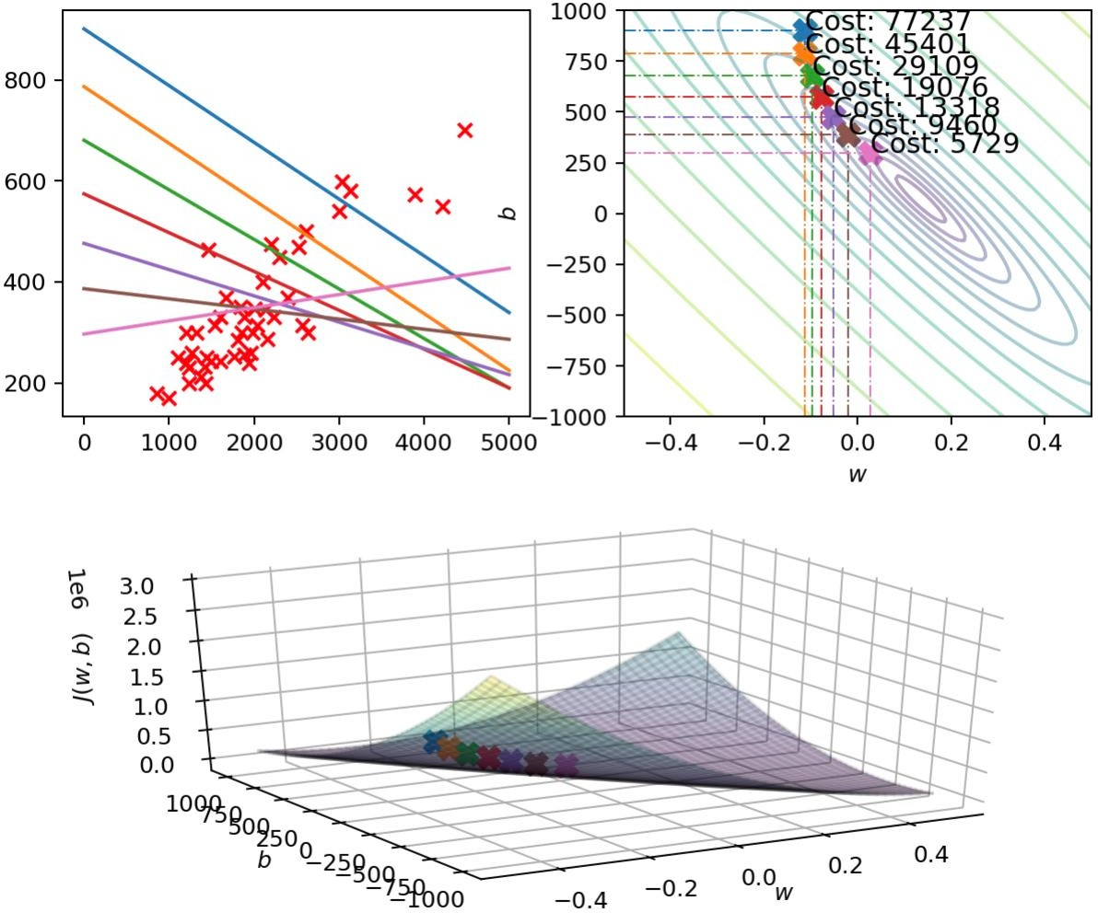
ƒ_{w,𝑏} 𝑠i𝑧𝑒
𝐽 𝑤, 𝑏
pric e in
$1000's
size in feet²
𝐽 𝑤, 𝑏

Slide 42

ƒ_{w,𝑏} 𝑠i𝑧𝑒
𝐽 𝑤, 𝑏
pric e in
$1000's
size in feet²
𝐽 𝑤, 𝑏

Slide 43
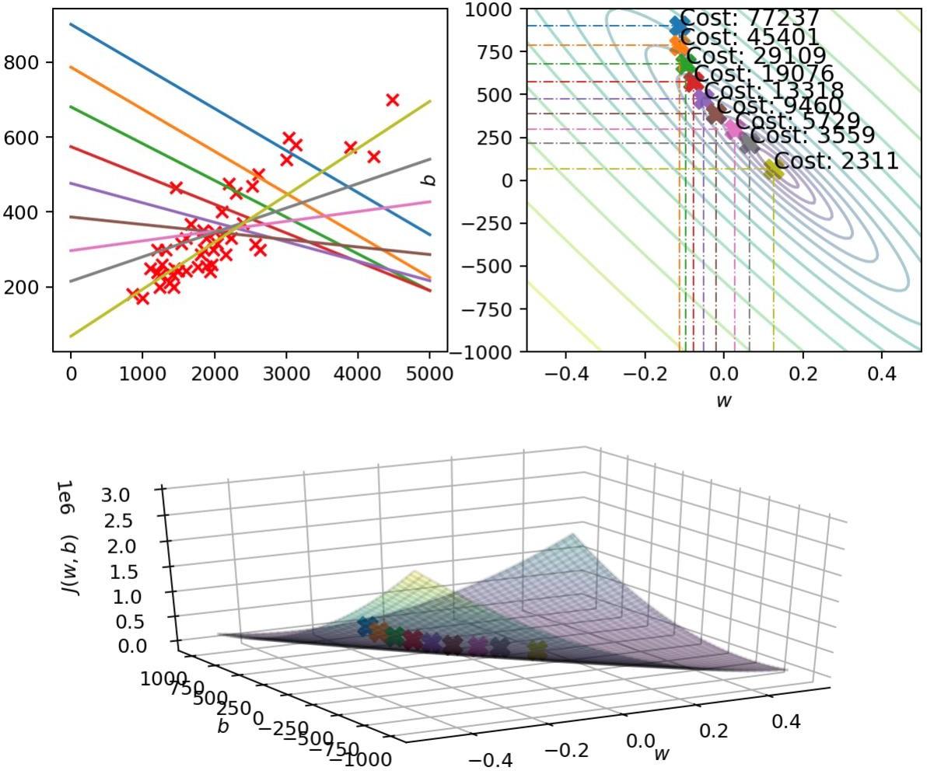


ƒ_{w,𝑏} 𝑠i𝑧𝑒
𝐽 𝑤, 𝑏
pric e in
$1000's
size in feet²
𝐽 𝑤, 𝑏

Slide 44




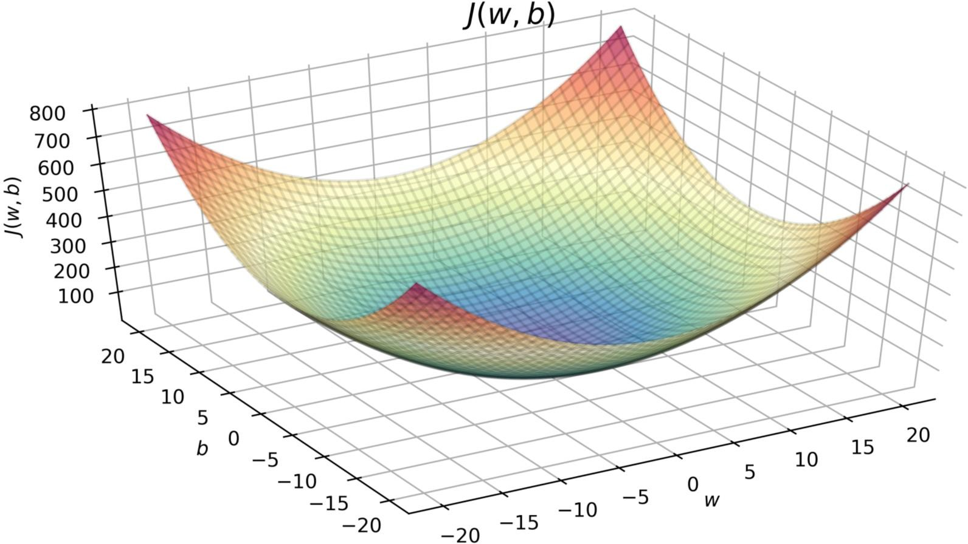
“Batch” gradient descent
“Batch”: Each step of gradient descent
uses all the training examples.
m = 47
𝑥
size in feet²
𝑦
price in $1000's
(1)
(2)
(3)
(4)
…
(47)
2104
1416
1534
852
…
3210
400
232
315
178
…
870

